Slide 1
Recursion cont’d
Lab 6 - March 20, 2024

Slide 2
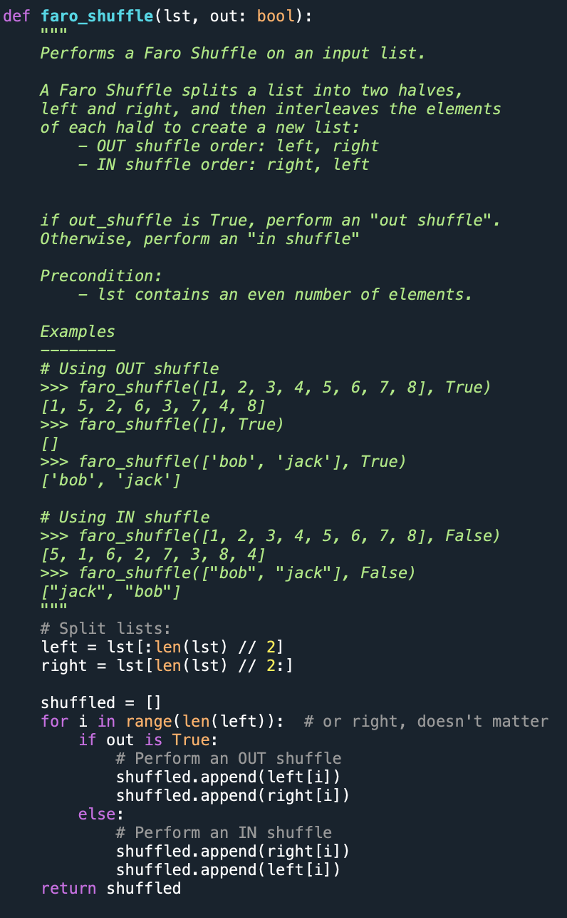
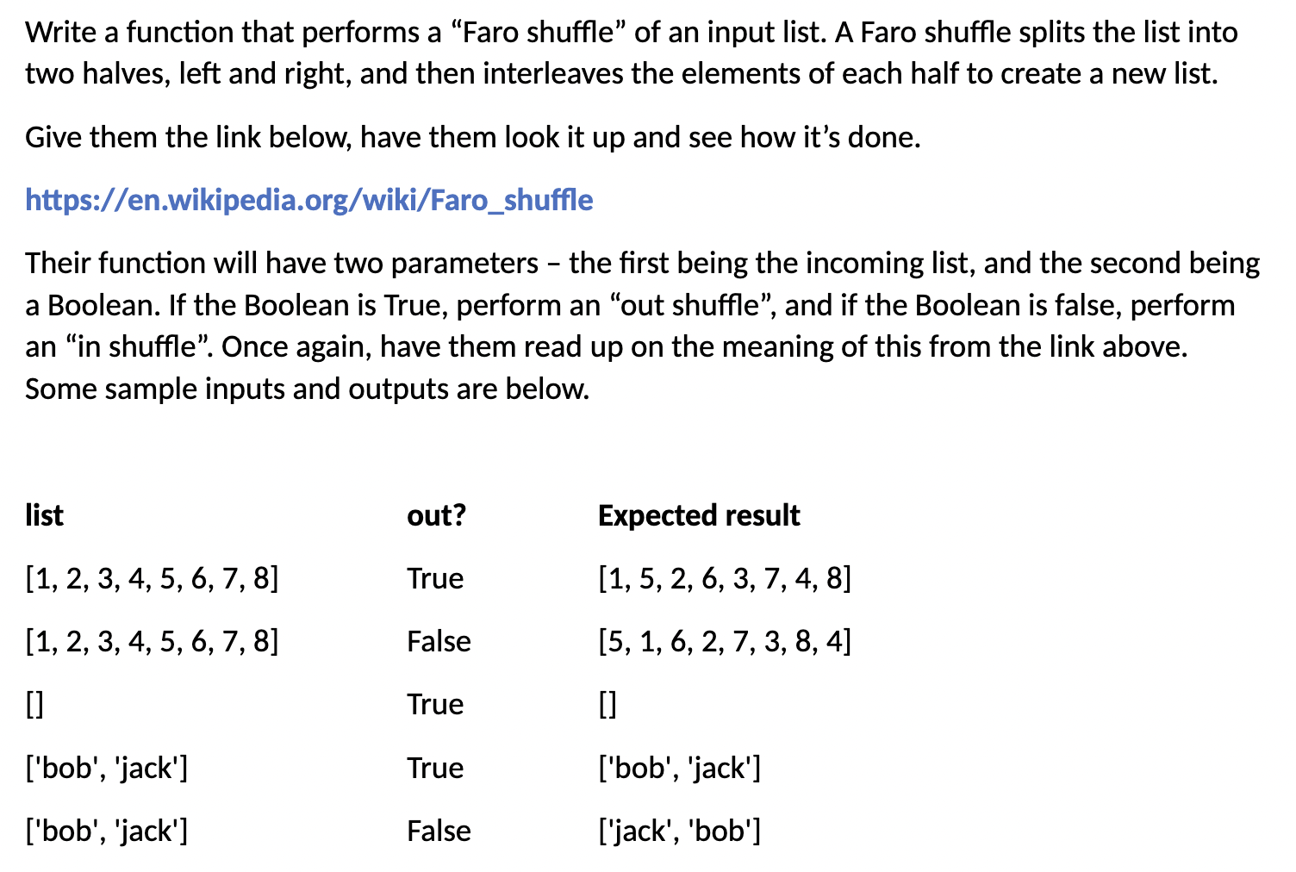
Lab 5 Quiz Solution

Slide 4
Review of Recursion - Main Idea

Slide 5
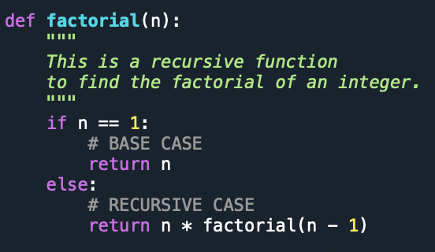
Recursive Implementation
This is a recursive function because it calls itself (i.e., in its function body)
When we call this function on a positive integer, it will recursively call itself by decreasing the number until the number reaches 1.

Slide 6
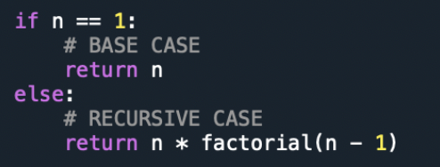
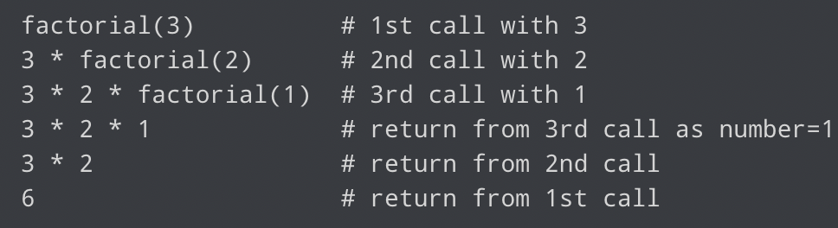
Out recursion ends when the number reduces to 1. This is called the base condition.

Slide 7
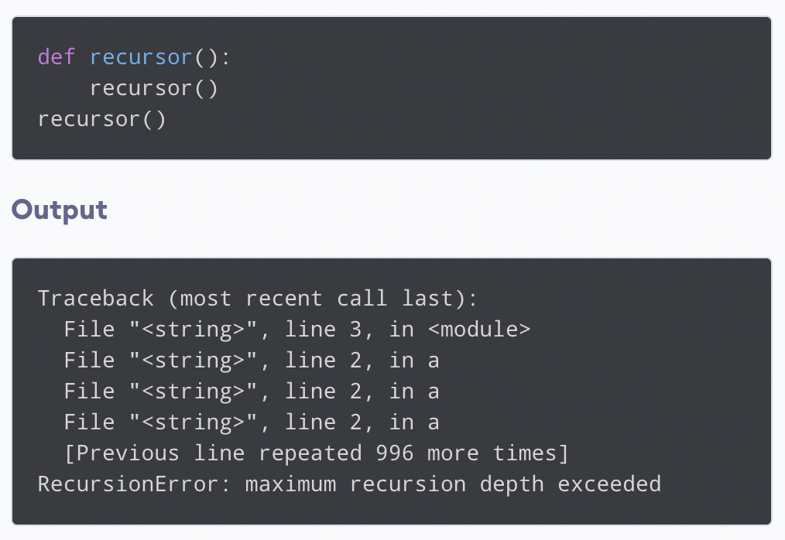
The Base condition
Every recursive function must have a base condition that stops the recursion OR ELSE the function will call itself infinitely.
Output:

Slide 8
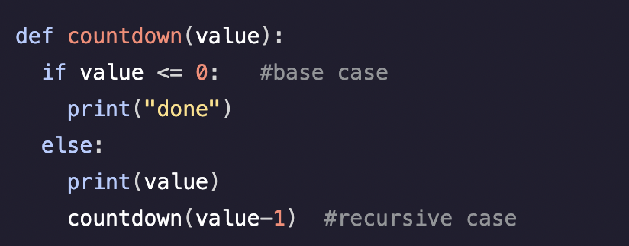
Recursion in Python

Slide 9
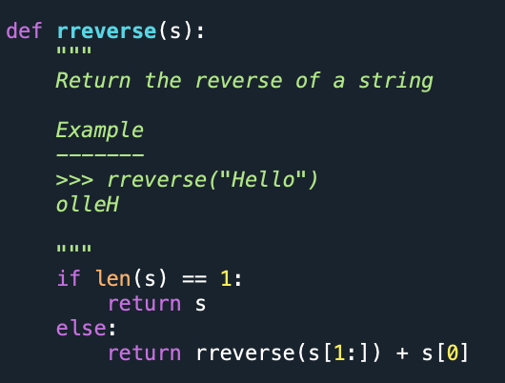
Reversing a String using Recursion

Slide 10
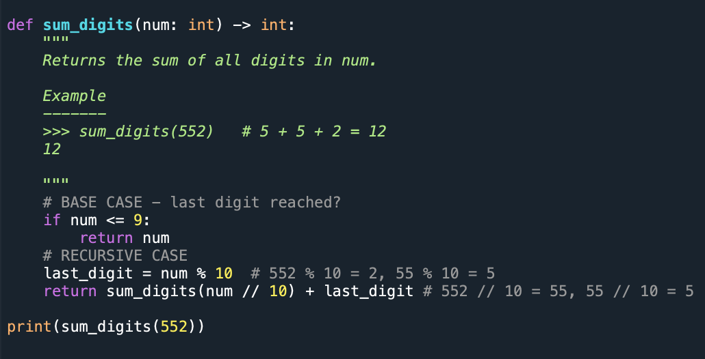
Sum Digits using Recursion

Slide 11
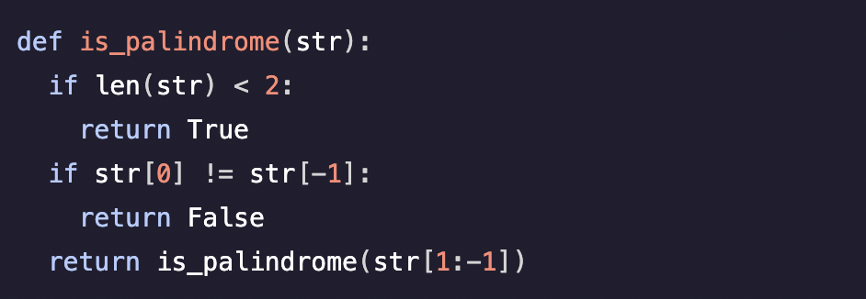
Determining if a String is a Palindrome
If there is only one in string. Return True
Else, compare first and last characters, and evaluate the inner characters (recurse).

